Slide 1
Object detection using advanced CNN.
Deep Learning Practical - 8

Slide 2
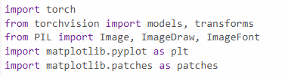
8-A: Object Detection Using Faster CNN (Advanced CNN)
import torch: This imports the PyTorch library, which is used for deep learning tasks. It provides functionalities like tensor operations, neural network layers, and pre-trained models.
from torchvision import models, transforms:
models: This module provides access to pre-trained deep learning models such as ResNet, VGG, etc. These models can be used for tasks like image classification, object detection, etc.
transforms: This is used to apply various transformations to images (like resizing, normalizing, etc.) before feeding them into a model for prediction.
from PIL import Image, ImageDraw, ImageFont:
Image: Used to open and manipulate images.
ImageDraw: Allows you to draw on images (e.g., adding text or shapes).
ImageFont: This helps you specify the font when adding text to an image.
import matplotlib.pyplot as plt: Matplotlib is a plotting library, and pyplot is a module within it used to create static, interactive, and animated visualizations. This line is used to plot graphs and images.
import matplotlib.patches as patches: This module provides classes to add shapes like rectangles, circles, and polygons to a plot. It is useful for tasks like drawing bounding boxes around objects in an image.
These imports are commonly used when performing tasks like image classification or object detection using pre-trained models, followed by drawing results on the image or visualizing them using plots.

Slide 3
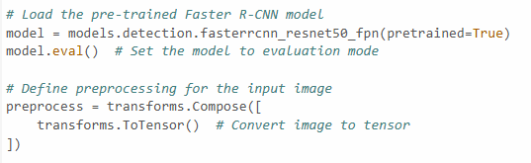
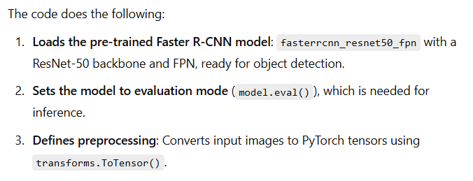

Slide 4
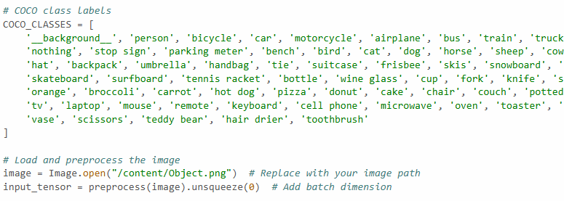
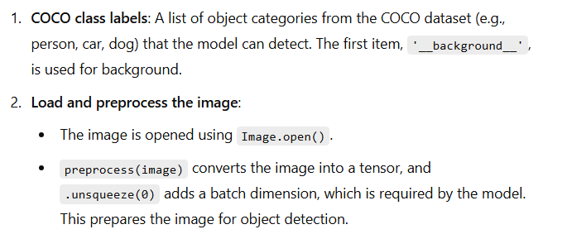

Slide 5
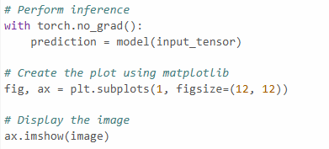
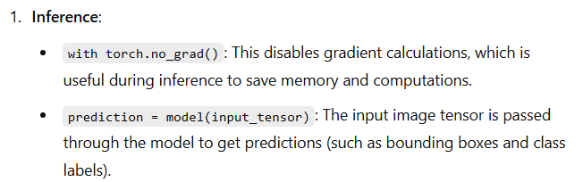
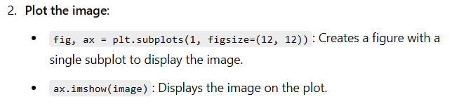

Slide 6
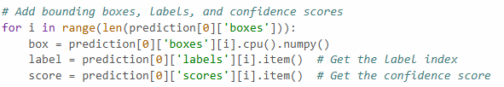
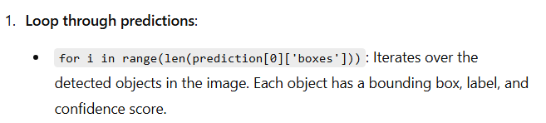
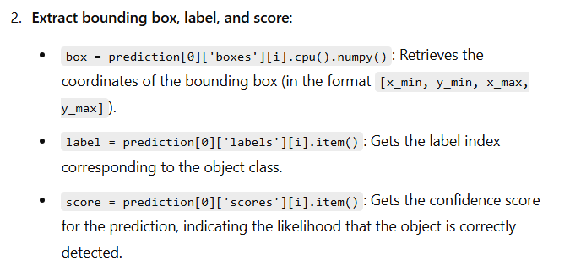

Slide 7
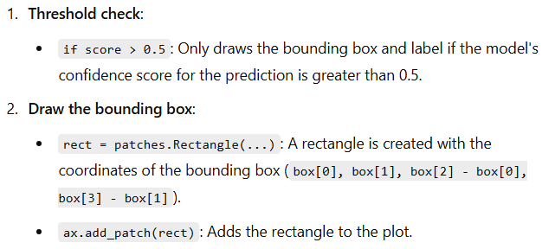
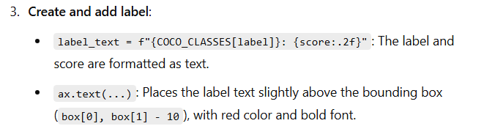
# If the score is above the threshold (e.g., 0.5), draw the box and label
if score > 0.5: # Draw the bounding box
rect = patches.Rectangle((box[0], box[1]), box[2] - box[0], box[3] - box[1], linewidth=2, edgecolor='red', facecolor='none’)
ax.add_patch(rect) # Create the label text with confidence label_text = f"{COCO_CLASSES[label]}: {score:.2f}"
# Add label text on top of the box
ax.text(box[0], box[1] - 10, label_text, color='red', fontsize=15, weight='bold’, verticalalignment='bottom')

Slide 8
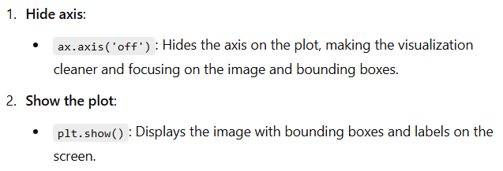
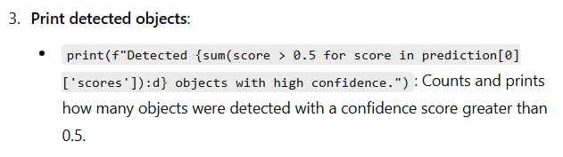
# Hide axis
ax.axis('off’)
# Show the image with bounding boxes and labels
plt.show()
# Print the number of objects detected with high confidence print(f"Detected {sum(score > 0.5 for score in prediction[0]['scores']):d} objects with high confidence.")

Slide 9
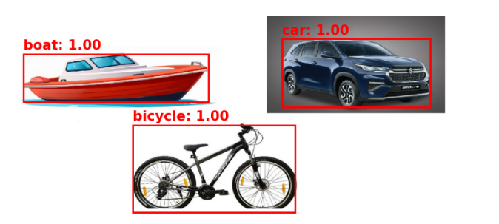

Slide 10

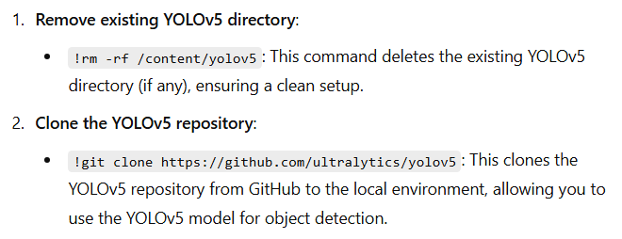
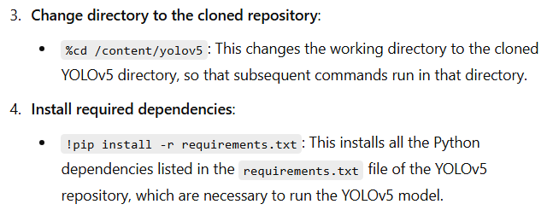
8-B: Object Detection Using YOLO

Slide 11
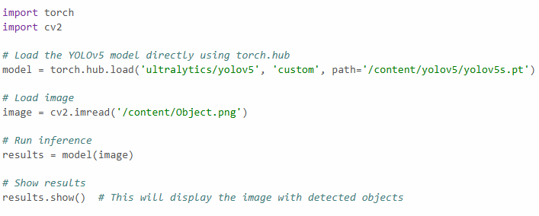
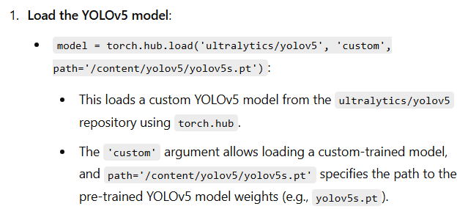
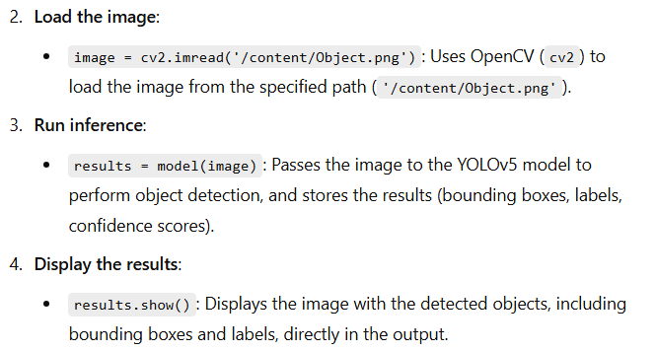

Slide 12
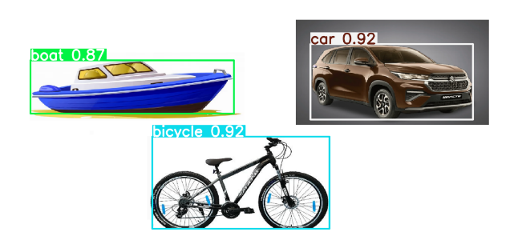

Slide 13
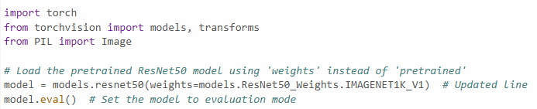
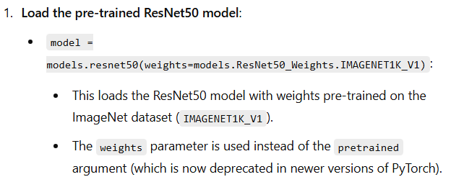
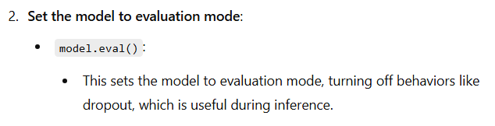
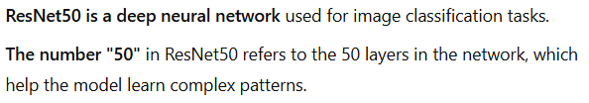
8-C: Object Detection using ResNet50

Slide 14
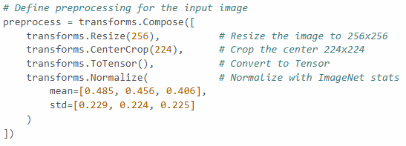
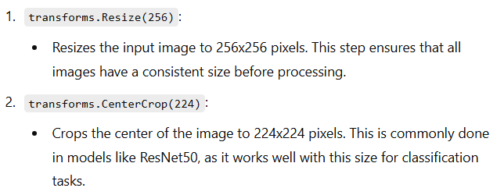
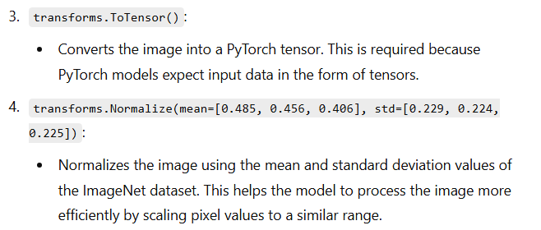

Slide 15
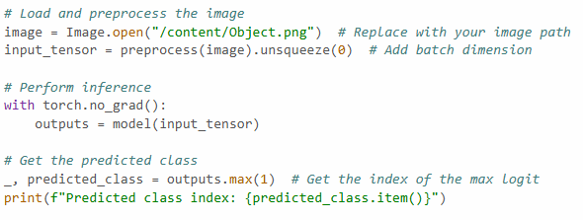
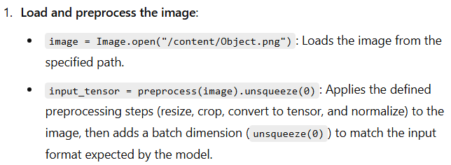

Slide 16
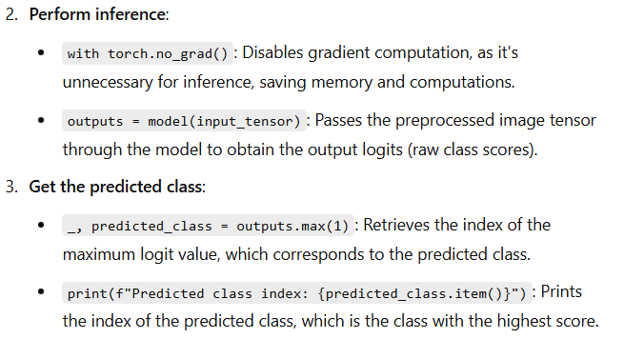

Slide 17
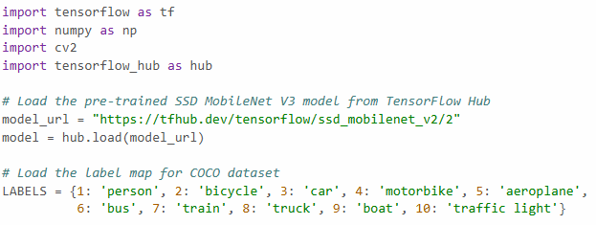
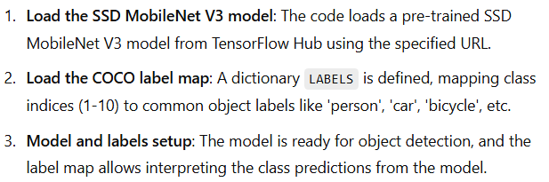
8-D: Object Detection using SSD MobileNet

Slide 18
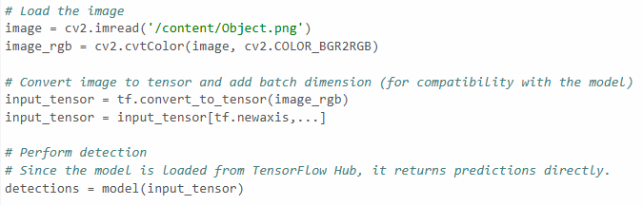
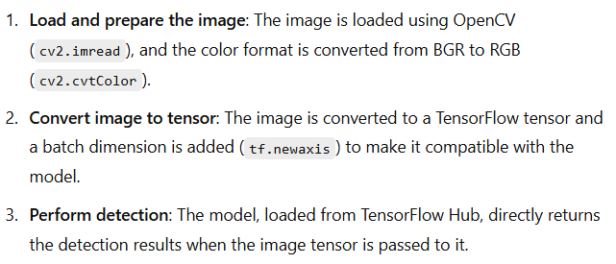

Slide 19
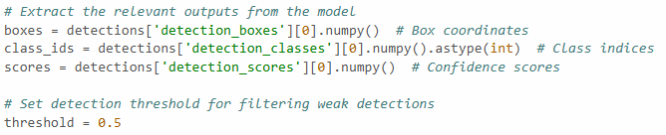
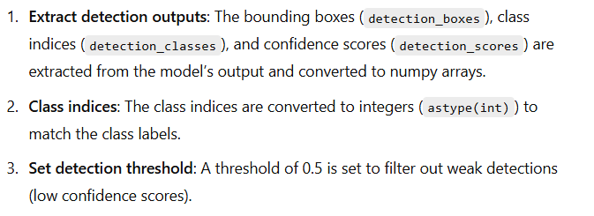

Slide 20
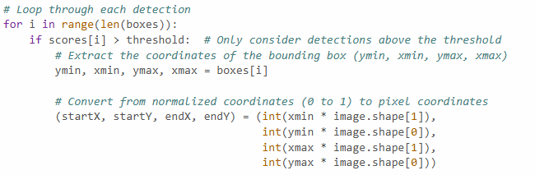
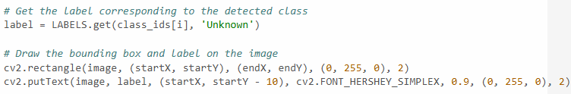
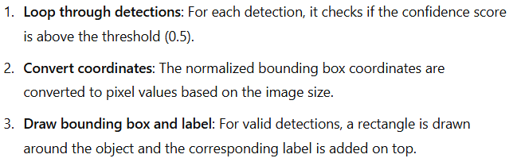

Slide 21
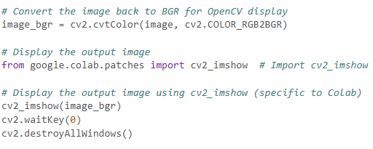
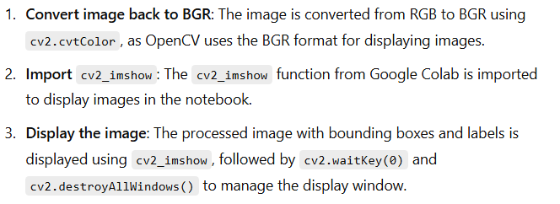

Slide 22
